Slide 1
APPLIED PHYSICS

Slide 2
Lecture 1 agenda:
Electric Charge.
Coulomb’s Law (electrical force between charged particles).

Slide 3
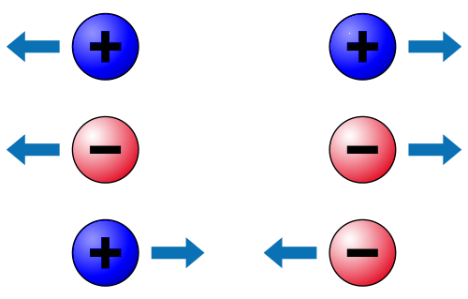
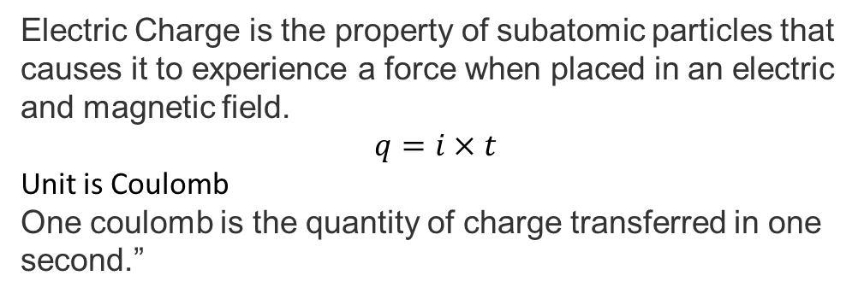
Electric Charge
Electric Charge is the property of subatomic particles that causes it to experience a force when placed in an electric and magnetic field.
$$q=i×t$$
Unit is Coulomb
One coulomb is the quantity of charge transferred in one second.”
-
Two kinds of charge:
+
like charges repel
unlike charges attract
Law of conservation of charge:
Net amount of charge does not change in any process

Slide 4
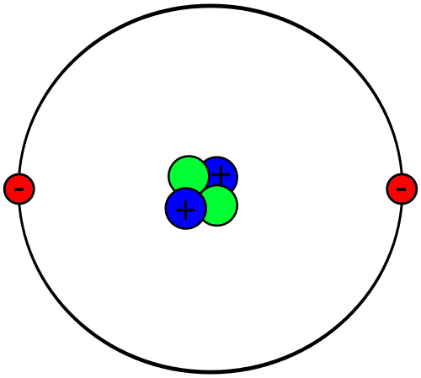
Charges are quantized (come in units of e= 1.6x10⁻¹⁹ C).
Elementary particles that make up atoms:
Protons charge +e = +1.6x10⁻¹⁹ C
Neutrons uncharged
Electrons charge –e = –1.6x10⁻¹⁹ C
+
-
Helium atom

Slide 5
Conductors
What are conductors?
Those materials through which electric charge can pass freely.
Examples
Metals such as copper, silver, gold etc
Human body
Water Tap
+
-

Slide 6
Insulators
What are insulators?
Those materials through which electric charge cannot pass freely.
Examples
Rubber
Plastic
Glass
+
-

Slide 7
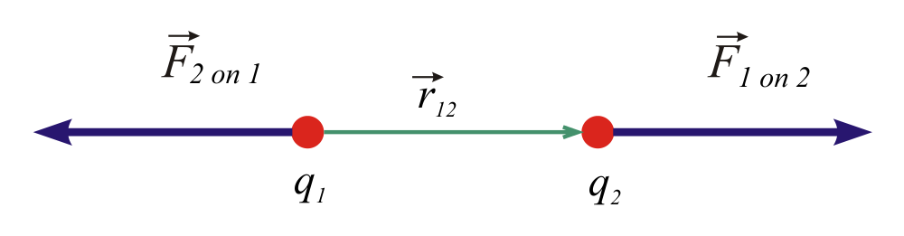
Coulomb’s Law
Force between two point charges q₁ and q₂:
force is vector, directed along connecting line
magnitude:
F12 is force on charge q1 due to q2
F21 is force on charge q2 due to q1
r₁₂ is the distance between the charges

Slide 8

Coulomb’s Law
Example
Consider the following figure. The charges are $q_{1}=1.60×{10}^{−19}C$ and $q_{2}=3.20×{10}^{−19}C$, and the particle separation is 0.02m. What are the magnitude of electrostatic force $F_{12}$ on particle 1 from particle 2?

Slide 11

Coulomb’s Law
Example
Consider the following figure. Particle 3 has charge $q_{3}=−3.20×{10}^{−19}C,$and the particle separation is 0.015m. What are the magnitude of electrostatic force $F_{13}$ on particle 1 from particle 3? Calculate the net electrostatic force $F_{1, net}$ on particle 1 due to particle 2 and 3.

Slide 13

Coulomb’s Law
Example
Consider the following figure. Particle 4 has charge $q_{4}=−3.20×{10}^{−19}C,$and the particle separation is 0.015m, and lies on a line that makes an angle of ${60}^{°}$with x-axis. What are the magnitude of electrostatic force $F_{14}$ on particle 1 from particle 4? Calculate the net electrostatic force $F_{1, net}$ on particle 1 due to particle 2 and 4.

Slide 15
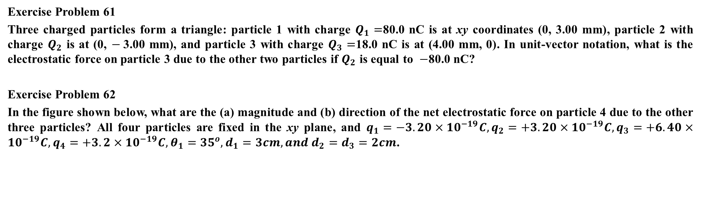
Coulomb’s Law
Exercise Problem 61
Three charged particles form a triangle: particle 1 with charge $Q_{1}=$80.0 nC is at xy coordinates (0, 3.00 mm), particle 2 with charge $Q_{2}$ is at (0, $−$3.00 mm), and particle 3 with charge $Q_{3}=$18.0 nC is at (4.00 mm, 0). In unit-vector notation, what is the electrostatic force on particle 3 due to the other two particles if $Q_{2}$ is equal to $−$80.0 nC?
Exercise Problem 62
In the figure shown below, what are the (a) magnitude and (b) direction of the net electrostatic force on particle 4 due to the other three particles? All four particles are fixed in the xy plane, and $q_{1}=−3.20×{10}^{−19}C,q_{2}=+3.20×{10}^{−19}C,q_{3}=+6.40×{10}^{−19}C,q_{4}=+3.2×{10}^{−19}C, θ_{1}={35}^{o}, d_{1}=3cm, and{ d}_{2}=d_{3}=2cm$.

